Slide 1
Plan
By Jack Coleman

Slide 2
Type checking and Creation
hashmap types = Integer : exact-integer?
Number : number?
Real : real?
Complex : complex?
Boolean : boolean?
String : string?
Character : char?
Pair : pair?
List : list?
Vector : vector?
new type HomList a = (lambda (l a) (and (list? l) (apply and (map a l))))

Slide 3
Type checking and Creation
hashmap types = Integer : exact-integer?
Number : number?
Real : real?
Complex : complex?
Boolean : boolean?
String : string?
Character : char?
Pair : pair?
List : list?
Vector : vector?
HomList : homlist?

Slide 4
Type checking
(define (typechecker f . args)
(let (result (apply f args))
(if (and (integer? (car args))
(integer? (car (cdr args)))
(integer? result))
result
(error "Error type mismatch!"))))
Int -> Int -> Int
(define (f x y)
(+ x y))
Expanded via macro

Slide 5
Function polymorphism
Int -> Int -> Int
(define (f x y)
(+ x y))
Real -> Real -> Real
(define (f x y)
(+ x y))
(f:Int->Int->Int x y)
(f:Real->Real->Real x y)
Under the hood...

Slide 6
Contracts?
https://docs.racket-lang.org/guide/contract-func.html

Slide 7
typeof
(define (typeof x)
(define (transverse-hash x l)
(cond ((null? l) #f)
(((cdr (car l)) x) (car (car l)))
(else (transverse-hash x (cdr l)))))
(transverse-hash x types))

Slide 8
Currying
x
y
x
y
add
add-x
add
result
result

Slide 9
Currying
https://docs.racket-lang.org/reference/procedures.html#%28def._%28%28lib._racket%2Ffunction..rkt%29._curry%29%29

Slide 10
Parametric polymorphism
add :: a -> a -> a
add x y = x + y

Slide 11


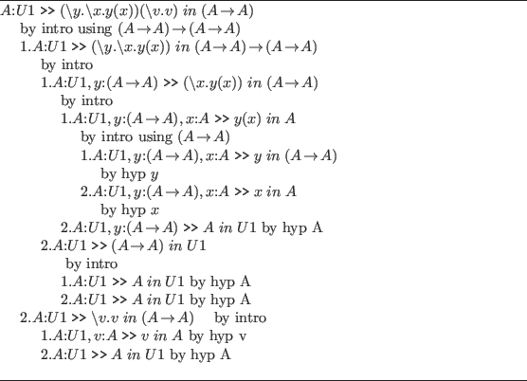

Set back and distractions

Slide 12

Haskell
But steel is heavier than feathers...
{-# LANGUAGE TypeFamilies #-}
{-# LANGUAGE GADT #-}
{-# LANGUAGE MultiParamTypeClasses #-}

Slide 13
Soundness and Completeness
A positive program is a program with an error.
A negative program is a program without an error.
Rows: Actual Value; Columns: Calculated
 | Positive | Negative
Positive
Negative
Completeness: No false positives
Sound: No false negatives

